Slide 1
Converting Casual Riders to Annual Members
Cyclistic
August 2026

Slide 2
Problem
How do annual members and casual riders use Cyclistic bikes differently, and how can these insights be leveraged to design a targeted marketing strategy aimed at converting casual riders into annual members?

Slide 3
Solution
Offer discounted pricing or lower the price for annual memberships to increase the conversion rate of casual riders into members.

Slide 4
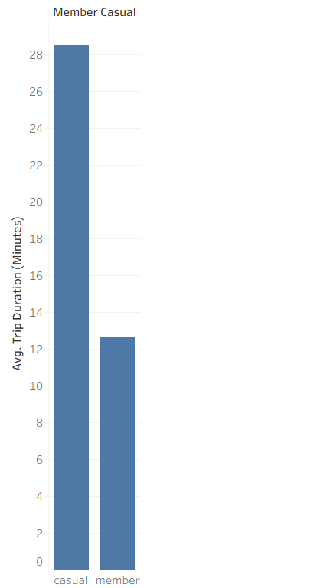
Why
REASON:
Casual riders take significantly longer individual trips on average (~28 minutes) compared to annual members (~13 minutes).

Slide 5
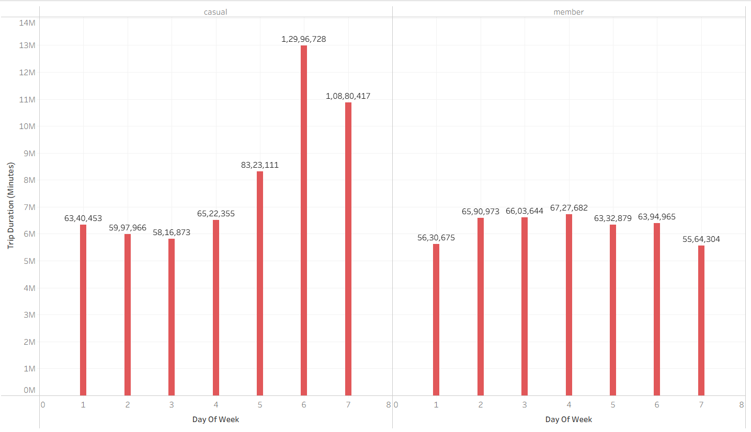
HOW
REASON:
Casual rider activity
spikes dramatically on
weekends (days 6 and 7),
while annual members
maintain steady, consistent
usage every day of the week
for commuting.

Slide 6
Summary
Proper pricing incentives and discounts can bridge the gap and turn high-engagement casual weekend riders into loyal annual members.

Slide 7
Further Recommendations
Conduct expanded customer surveys to capture deeper qualitative insights and more precise user preferences for future decision-making.

Slide 8
Thank you

